Slide 1
Scientific Theory in Informatics
Computation: Complexity Theory
Richard Senington
Based on slides by David Vernon & Göran Falkman
University of Skövde
Richard.james.senington@his.se

Slide 2
Automata Revisited
Seminar tomorrow at 10am
G207

Slide 3
Computation Seminar Oct 7th
Problems and groups have now been posted

Slide 4
Last week
Computability,
Finite State Automata
Push Down Automata
Turing Machines
Decidable problems
Algorithm exists for problem
Computation will end
Undecidable problems
Computation might never end

Slide 5
Motivation
Analysis of the complexity of algorithms:
How to compute, or estimate, the time (and space) complexity of algorithms?
What effects the complexity of computer programs?
Why study complexity theory?
Some problems seem easy and some seem hard
Is this the case? Are there intrinsically easy or hard problems?
Which problems can efficiently be solved by a computer?
Decide on pros and cons of different solutions
Practice vs. theory:
Worst-case vs. average case vs. asymptotic (long-run) complexity

Slide 6
Lecture Overview
Complexity theory
Easy problems (sort a million items in a few seconds)
Hard problems (schedule a thousand classes in a hundred years)
What makes some problems hard and others easy (computationally) and how do we make hard problems easier?
Complexity theory addresses these questions
Analysis of the complexity of algorithms
Measuring and analyzing time complexity – in theory and in practice
Classification of algorithms and problems
P, NP, NP-Hard and NP-Complete classes of algorithms

Slide 7
What Affects Time Complexity?
Performance (speed) of the hardware
Quality of the compiler/interpreter (the code it generates)
Skill of the programmer
Size of the problem instance and the characteristics of the input
Choice of algorithm
The inherent complexity of the problem

Slide 8
Complexity Analysis
How to measure the time complexity of programs?
Empirically: Run the program for different inputs and measure the computation time:
Expensive and problematic
Cannot test every possible input
Can only be performed after implementation
Amortized analysis:
How does the program perform during the long run of its lifetime?
Even more problematic
Theoretically: Perform a rigorous mathematical analysis of the underlying algorithm as run on a general computational platform:
Can be done before resources are put into the implementation of the program
Gives an undisputable “truth”

Slide 9
Time Complexity
Time complexity as a function of the size of the input to the program:
T(n) = the time it takes to perform an algorithm on input of size n
Interested in the case when n is (very) large, i.e., in asymptotic complexity
Running time is not everything:
For programs that are seldom used development costs dominates everything else
If small inputs dominate, an advanced algorithm may bring unnecessary overhead
An efficient algorithm is often very complex, i.e., hard to understand and maintain
A time-wise efficient algorithm may require large amounts of memory
For numeric algorithms exactness and stability are equally important

Slide 10
Time Complexity: Simple Examples
Program 1
x := x + 1
Program 2
FOR i := 1 to n
DO
x := x + 1
END
Program 3
FOR i := 1 to n
DO
FOR j := 1 to n
DO
x := x + 1
END
END
Frequency = 1
Frequency = n
Frequency = n²

Slide 11
How to Analyze Time Complexity?
Assume the use of a sequential computer (von Neumann architecture) with infinite memory capacity and instant access to input and output streams (no interaction):
All atomic statements have a cost of 1 time unit:
Assignment, arithmetic and logical operations, indexing of memory structures, etc.
Cost of consecutive instructions is the sum of the individual elements
Iterations:
While-loops: (Cost of test ⋅ (#iterations + 1)) + (cost of body ⋅ #iterations)
For-loops: Cost of initializations + (cost of test ⋅ (#iterations + 1)) + (cost of body ⋅ #iterations) + (cost of increasing counter ⋅ #iterations)
Nestled iterations are analyzed from the innermost loop and out
Results in an approximation of the total time taken, where statements that depend on the input size are decisive – frequency count in terms of input size

Slide 12
Orders of Magnitude
1, n, and n² are said to be different and increasing orders of magnitude (e.g., if n = 10 then we get 1, 10 and 100)
We are interested in determining the order of magnitude of the time complexity of an algorithm.
T(n)
n² (quadratic)
n (linear)
1 (constant)
n
50
100

Slide 13
Time Complexity: Fibonacci Sequence
Let’s look at an algorithm to print the n^{th} term of the Fibonacci sequence:
0 1 1 2 3 5 8 13 21 34 …
as given by
t₀ = 0
t₁ = 1
t_{n} = t_{n−1} + t_{n−2}
n > 1
0
1
1
0
1
0
1
0
1
1
1
n
1
1
1
1
1
procedure fibonacci {print nth term}
read(n)
if n<0
then print(error)
else if n=0
then print(0)
else if n=1
then print(1)
else
fnm2 := 0;
fnm1 := 1;
FOR i := 2 to n DO
fn := fnm1 + fnm2;
fnm2 := fnm1;
fnm1 := fn
end
print(fn);
T(n) = 8+4n

Slide 14
Big-O Notation
The cases where n < 0, n = 0 and n = 1 are not particularly instructive or interesting. In the case where n > 1, we have the total statement frequency of:
T(n)=8 + 4n
We write this as 8+4n = O(n), thus ignoring the constants
More formally, f(n) = O(g(n)) – read as “f of n is big-O of g of n” – where g(n) is an asymptotic upper bound for f(n)
f(n) = O(g(n))
if there exist two constants c and k such that
f(n) ≤ c ⋅ g(n) for all n ≥ k
“f(n) never gets worse than g(n) (for large enough n)”

Slide 15
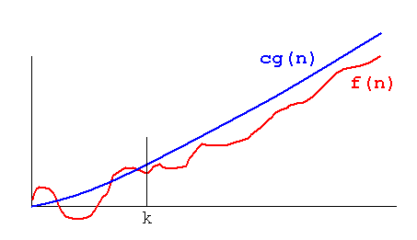
Big-O Notation
Suppose f(n) = 2n² + 4n + 10.
Then f(n) = O(g(n)) for g(n) = n², c = 16 and k = 1:
f(n) = 2n² + 4n + 10
f(n) ≤ 2n² + 4n² + 10n² for n ≥ 1
f(n) ≤ 16n²
f(n) ≤ 16g(n)
Usually one seeks as tight an upper bound as possible
Notes:
Över en viss indatastorlek (n0) kommer T(n) att begränsas uppåt av en kurva av samma form som f(n) (endast en konstant faktor skiljer).
Används för att beskriva en övre gräns för T(n); T(n) blir aldrig sämre.
Obs! Vill ha en så tight gräns som möjligt (så litet c som möjligt).
Exempel:
3n_2 – 2n + 3 in O(n_2).
2n – 3 in O(n)
6_(2n) – 2_n + n_2 in O(a_n)

Slide 16
Arithmetic of Big-O Notation
If T₁(n) = O(f(n)) and T₂(n) = O(g(n)) then
T₁(n) + T₂(n) = O(max(f(n), g(n))
If f(n) ≤ g(n) then
O(f(n) + g(n)) = O(g(n))
If T₁(n) = O(f(n)) and T₂(n) = O(g(n)) then
T₁(n) ⋅ T₂(n) = O(f(n) ⋅ g(n))
Example:
f₁(n) = 10n + 25n² ⇒
f₁(n) ≤ 10n² ⁺ 25n² ⇒ // 10n ≤ 25n²
f₁(n) = O(n²)

Slide 17
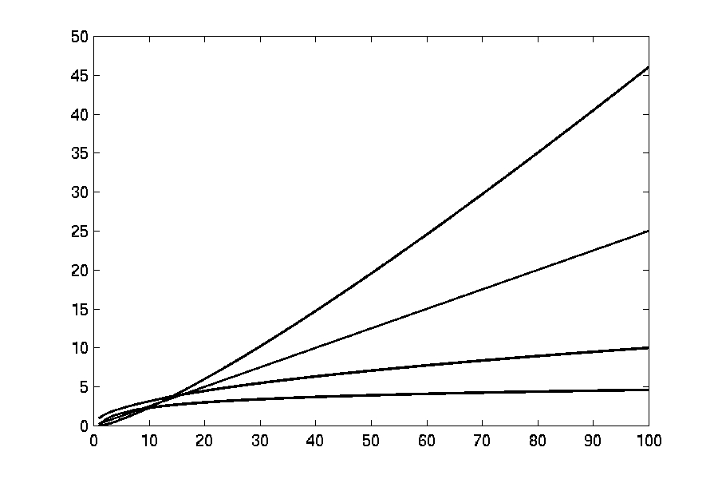
Orders of Magnitude Revisited
n log(n)
n
log(n)

Slide 18
Orders of Magnitude Revisited (2)
O(1) Constant (computing time)
O(log n) Logarithmic (computing time) is faster than O(n) for sufficiently large n
O(n) Linear (computing time)
O(n log n) “n log n” is faster than O(n²) for sufficiently large n
O(n²) Quadratic (computing time)
O(n³) Cubic (computing time)
O(2^{n}) Exponential (computing time)

Slide 19
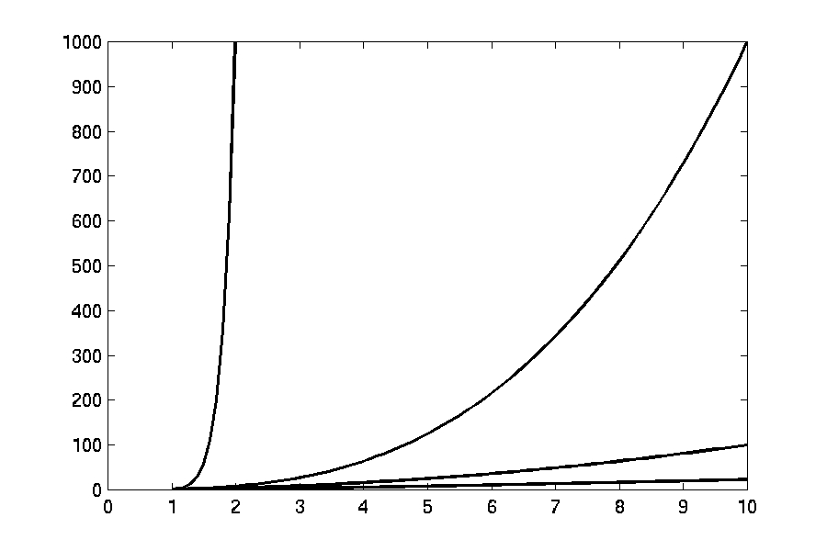
Orders of Magnitude Revisited (3)
n¹⁰
n³
n²
n log(n)

Slide 20
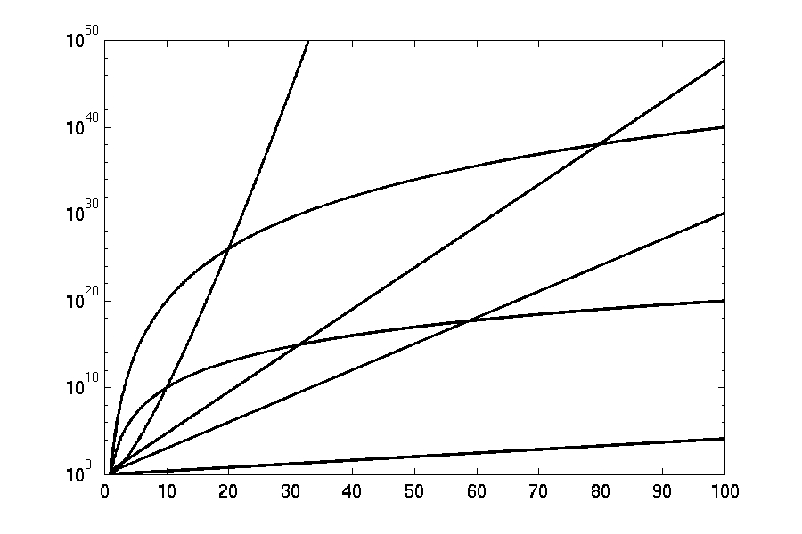
Orders of Magnitude Revisited (4)
3^{n}
n^{n}
n²⁰
2^{n}
Log Scale
n¹⁰
1.1^{n}

Slide 21
Orders of Magnitude Revisited (5)
The effect on running time T(n) if n is doubled in size:
Constant no increase: T(2n) = T(n)
log n small increase: T(2n) > T(n)
n (linear) doubled running time: T(2n) = 2T(n)
n log n little more than doubled running time: T(2n) > 2T(n)
n² increase with a factor 4: T(2n) = 4T(n)
n³ increase with a factor 8: T(2n) = 8T(n)
2^{n} quadratic increase: T(2n) = T(n)²

Slide 22
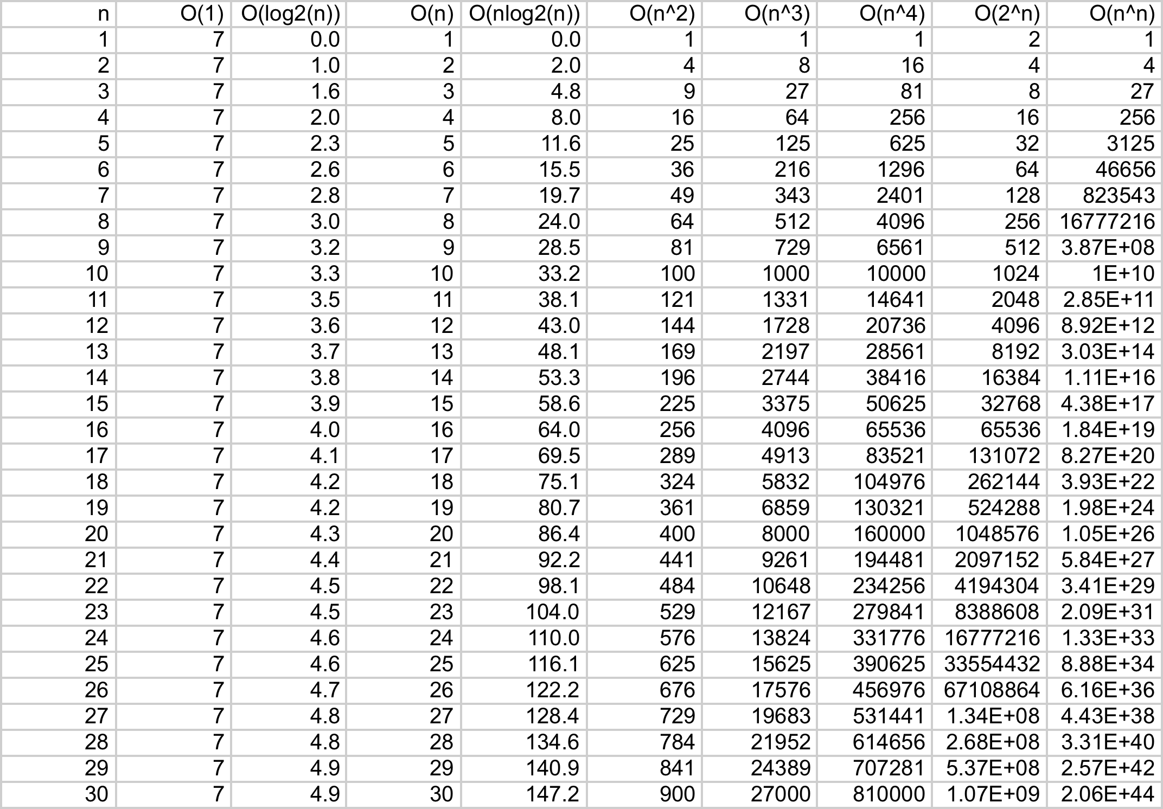
Time Complexity

Slide 23
Orders of Magnitude Revisited (6)
If we had a computer a 1,000, 1,000,000 or 1,000,000,000 times faster …
Operations per second | N=1 million (10⁶) |  |  | N=1 billion (10⁹)
 | n | nlogn | n² | n | nlogn | n²
10⁶ | seconds | seconds | weeks | hours | hours | never
10⁹ | instantly | instantly | Hours | seconds | seconds | decades
10¹² | instantly | instantly | Seconds | instantly | instantly | weeks
10¹⁵ | instantly | instantly | instantly | instantly | instantly | minutes

Slide 24
Complexity of Recursive Algorithms
n! (factorial) = 1 ⋅ 2 ⋅ 3 ⋅ … ⋅ n
fac(0) = fac(1) = 1
fac(n) = n ⋅ fac(n−1)
n > 1
1
1
1
0
2 + T(n-1)
1
int factorial(int n){
int factorial_value;
factorial_value = 0;
if (n <= 1)
factorial_value = 1;
else
factorial_value = n * factorial(n-1);
return (factorial_value);
}

Slide 25
Complexity of Recursive Algorithms (2)
In general, this is more difficult:
Identify and solve the recurrence relation implicit in the recursion
T(n) = 6 + T(n−1) ⇒ T(n) = c + T(n−1)
T(n−1) = c + T(n−2) ⇒ T(n) = c + c + T(n−2) = 2c + T(n−2)
T(n−2) = c + T(n−3) ⇒ T(n) = 2c + c + T(n−3) = 3c + T(n−3)
…
T(n) = ic + T(n−i )
Finally, when i = n−1 the unfolding stops and we get:
T(n) = (n−1)c + T(n−(n−1)) = (n−1)c + T(1) = (n−1)c + d
Hence, T(n) = O(n)

Slide 26
More complex problems

Slide 27
Worst-, Average- and Best-Case Complexity
So far, we have looked only at worst-case time complexity, i.e., we have developed an upper-bound on running time
However, there are times when we are more interested in the average-case complexity or best-case complexity (especially if they differ significantly):
One of the fastest sorting algorithms, Quicksort, has T(n) = O(n²) worst-case complexity (for inversely sorted data), but T(n) = O(n log² n) average-case complexity (for randomly ordered data). Also the best-case complexity is T(n) = O(n log² n)
For another very fast sorting algorithm, mergesort, both the worst-, average- and best-case complexity is T(n) = O(n log² n), i.e., mergesort is more stable

Slide 28

Towers of Hanoi
The goal of this puzzle is to transfer all n disks from peg A to peg C using auxiliary peg B according to the following rules:
you can only move one disk at a time
you can never place larger disk above a smaller one
Recursive solution:
transfer n−1 disks from A to B
move largest disk from A to C
transfer n−1 disks from B to C
Recurrence relation:
T(n) = 2T(n−1) + 1
T(1) = 1

Slide 29
Complexity of the Towers of Hanoi
Solution by unfolding, which stops when i = n−1:
T(n) = 2(2T(n−2) + 1) + 1 = 4T(n−2) + 2 + 1
= 4(2T(n−3) + 1) + 2 + 1 = 8T(n−3) + 4 + 2 + 1 = ...
= 2^{i}⋅T(n−i) + 2^{i−1} + 2^{i−2} + ... + 2¹ + 2⁰
= 2^{n–1} + 2^{n–2} + 2^{n–3} + ... + 2¹ + 2⁰
This is a geometric sum, so we have T(n) = 2^{n}−1 = O(2^{n})
The running time of this algorithm is exponential (k^{n}) rather than polynomial (n^{k})
Good or bad news?
The Tibetan monks were confronted with a tower of 64 golden rings
Assuming one could move 1 million rings per second, it would take the monks half a million years to complete the process ...

Slide 30
Monkey Puzzle
Are such long running times linked to the size of the solution of an algorithm?
No! To show that, we in the following consider only True/False or Yes/No problems – decision problems
Nine cards with imprinted “monkey halves” with fixed orientations
Does any 3 × 3 arrangement of matching halves exist?
A brute-force algorithm to verify whether a solution exists is O(9!)

Slide 31
Monkey Puzzle
Brute force solution: Go through all possible arrangements. Assuming the number of cards is 25:
Pick a card and place it – there are 25 possibilities for the first placement
Pick the next card and place it – there are 24 possibilities
Pick the next card, there are 23 possibilities ...
There are 25 ⋅ 24 ⋅ 23 ⋅ 22 ⋅ … ⋅ 2 ⋅ 1 possible arrangements, i.e., factorial 25 possible arrangements (25!)
25! contains 26 digits, and with 1,000,000 arrangements per second it would take 490 billion years to solve the puzzle
A smarter algorithm can improve on this by discarding partial arrangements, but would still need thousands of years
Is there an easier way to find solutions? Perhaps, but nobody has found one, yet …

Slide 32
Reasonable vs. Unreasonable Algorithms
The order of complexity of the brute force algorithm for the Monkey Puzzle is O(n!) and n! grows at a rate which is orders of magnitude larger than polynomial functions
Other functions exist that grow even faster, e.g., n^{n} (super-exponential)
Even functions like 2^{n} have unacceptable sizes even for modest values of n
Number of microseconds since “Big-Bang”

Slide 33
Reasonable vs. Unreasonable Algorithms
function/ n | 10 | 20 | 50 | 100 | 300
n² | 1/10,000 second | 1/2,500 second | 1/400 second | 1/100 second | 9/100 second
n⁵ | 1/10 second | 3.2 seconds | 5.2 minutes | 2.8 hours | 28.1 days
2^{n} | 1/1000 second | 1 second | 35.7 years | 400 trillion centuries | a 75 digit-number of centuries
n^{n} | 2.8 hours | 3.3 trillion years | a 70 digit-number of centuries | a 185 digit-number of centuries | a 728 digit-number of centuries
Polynomial
Exponential

Slide 34
Tractable vs. Intractable Problems
Tractable problems
”Good”, reasonable algorithms are known, i.e., complexity is bound by a polynomial function T(n) = a_{k}n^{k} + a_{k−1}n^{k−1} + … + a₁n + a₀
Intractable problems
Only ”bad”, unreasonable algorithms are known, i.e., complexity is bound by a superpolynomial (exponential) function T(n) = a^{n}

Slide 35
So What!
Computers become faster every day!
As we’ve seen, for these algorithms it doesn’t matter if we get a computer a billion, or trillion, times faster
The number of computed operations per second is insignificant – just a constant – compared to expected total running time
This only applies to “toy examples” as the Monkey puzzle, which are of no concern!
The Monkey puzzle is just an illustrative example of a general class of important optimization problems that fall into a category called NPC
NPC (NP-Complete) includes ~1000 fundamentally important problems, e.g.,
Travelling Salesman Problem (TSP)
Graph Coloring Problem
Satisfiability Problem (SAT)
Clique Problem
For all these problems, no reasonable algorithm is known, i.e., they are all intractable problems

Slide 36
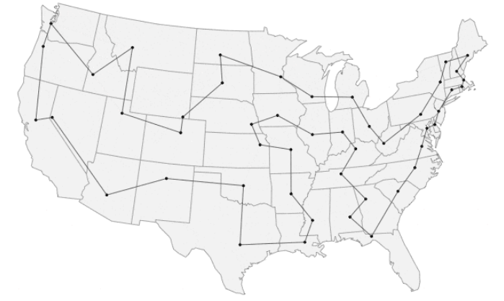
Travelling Salesman Problem (TSP)
TSP is the problem of a salesman who wants to find, starting from his home town, a shortest possible trip through a given set of customer cities and to return to its home town, visiting exactly once each city
Naive solutions are O(n!), where n is the number of cities
Best known exact solution is O(n²⋅2^{n}) (from 1962)
Heuristic (approximate) solutions have manage to solve the problem for 85,900 cities (from 2006)
The minimum trip visiting all of Sweden’s 24,978 municipalities is 72,500 km long (from 2004)

Slide 37
Complexity Classes

Slide 38
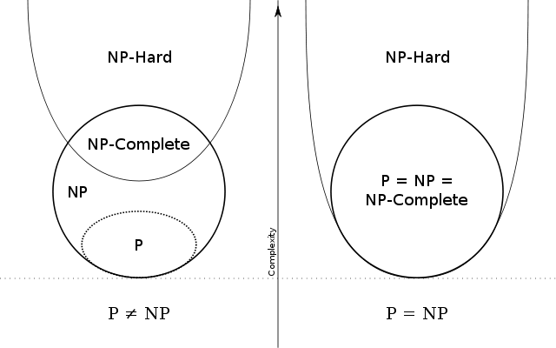
Complexity Classes

Slide 39
Changing classes – Cubic equations
2x³ − 3x² − 3x + 2 – SOLVE
Historically quite hard in general (pre 1400)
Scipione del Ferro (died 1526) found he could solve
x³ + mx = n
He told only 1 student Antonio Fior (just before del Ferro died)
1530, Niccolò Tartaglia found he could solve
x³ + mx² = n
A competition between Tartaglia and Fior, with bets
Tartaglia wins, figuring out Ferro’s trick
Gerolamo Cardano manages to synthesis a complete formulation

Slide 40
P and NP Complexity Classes
P is the set of all decision problems solvable in polynomial time on a deterministic Turing machine, i.e., on a computer as we know it
NP is the set of all decision problems solvable in polynomial time on a nondeterministic Turing machine, i.e., on an imaginary “oracle-based” computer:
For all decision points in an algorithm we can, in constant time, make a perfect guess on the best choice (e.g., pick the right Monkey Card or select the optimal next leg in the Traveling salesman’s trip)
Alternatively: NP is the set of all decision problems for which solutions can be verified through a reasonable (polynomial) algorithm (the verifier) by providing a proof (certificate)

Slide 41
P and NP Complexity Classes (2)
From before we know that the Monkey Puzzle is not in P. However, given a proposed arrangement of the Monkey Puzzle cards you can easily (i.e., in polynomial time) check whether the arrangement is a solution to problem or not, i.e., the Monkey Puzzle is NP:
We only need to provide a solution – a certificate
From before we know that the Traveling Salesman is not in P. However, given a proposed trip you can not easily (i.e., not in polynomial time) check whether the trip is an optimal solution to the problem or not, i.e., the Traveling Salesman is not NP:
Checking whether the proposed solution is a certificate or not has the same complexity as the original problem

Slide 42
NP-Hard and NP-Completeness
A NP-Hard (non-deterministic polynomial-time hard) problem is at least as hard as the hardest problems in NP:
A problem H is NP-hard when every problem L in NP can be reduced in polynomial time to H
NP-Complete (NPC) problems are NP problems that are NP-hard:
The NP-complete class of problems include the computationally hardest problems known
Each NPC problem’s fate is tightly coupled to all the others:
Finding a polynomial time algorithm for one NPC problem would automatically yield an a polynomial time algorithm for all NP problems – Either all NPC problems are tractable or none of them are
Proving that one NPC problem has an exponential lower bound would automatically prove that all other NP-complete problems have exponential lower bounds – Either all NPC problems are intractable or none of them are

Slide 43
The Big Question

Slide 44
The Big Question (2)
If P = NP, then
There are efficient algorithms for TSP and factoring
Cryptography is impossible on conventional machines
Modern banking system will collapse
If not, then
Can’t hope to write efficient algorithm for TSP
But maybe efficient algorithm still exists for testing the primality of a number – i.e., there are some problems that are NP, but not NP-complete
Probably no, since
Thousands of researchers have spent four decades in search of polynomial algorithms for many fundamental NP-complete problems without success
Consensus opinion: P ≠ NP
But maybe yes, since
No success in proving P ≠ NP either

Slide 45
Summary
Complexity theory:
A polynomial-time algorithm is one that is bounded from above by some function n^{k} for some fixed value of k:
Reasonable algorithm
A superpolynomial (exponential and super-exponential) time algorithm is one that is bounded from above by some function k^{n} for some fixed value of k:
Unreasonable algorithm
Computational theory:
P – class of problems which admit deterministic polynomial-time algorithms
NP – class of problems which admit non-deterministic polynomial-time algorithms
NP-Hard – problems at least as hard as NP problems (every NP problem can be transformed to an NP-Hard problem in polynomial time)
NP-Complete – NP-problems that are NP-hard

Slide 46
Summary (2)
So, is NP = P or not?
We don’t know!
The NP = P? problem has been open since it was posed in 1971 and is one of the most difficult unresolved problems in computer science
It is not known whether the whole class of NP problems are tractable or intractable
But, there exist provably intractable problems
Even worse – there exist problems with running times unimaginably worse than exponential
More bad news: there are provably non-computable (undecidable) problems
There are no (and there will never be) algorithms to solve these problems

